Slide 1
XARXA CAPACITEM PILOT PROJECT
FOR THE PROMOTION OF SOCIAL AND LABOUR INCLUSION OF PEOPLE WITH DISABILITIES OR MENTAL HEALTH ISSUES

Slide 2
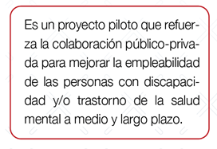
Project basis:
Goal 8 of the 2030 Agenda details the need to promote sustained, inclusive and sustainable economic growth, full and productive employment and decent work for all. Goal 5 focuses on achieving full and productive employment and decent work for all women and men, including for young people and persons with disabilities, and equal pay for work of equal value.
Project:
Notes:
LABORA is the Public Employment and Training Service for the Valencian Community, a public organisation of the GV that falls under the Regional Ministry for Sustainable Economy, Productive Sectors, Trade and Labour.
In our Espai Labora offices, you will find professionals prepared to help you improve your job prospects and we will assist each person according to their needs.
We'll accompany you on your job seeking journey.
We'll help you to improve your training.
We'll put you in touch with business and organisations.
We offer assistance and grants.
Pilot project that strengthens public/private collaboration to improve the medium- and long-term employability of people with disabilities and/or mental health issues.

Slide 3
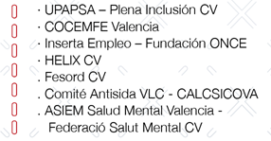
This initiative arose thanks to the cooperation of:
Through its lead group:

Slide 4
Strategic objective:
Integration of the Xarxa Capacitem methodology for helping people with disabilities and/or mental health issues to create an Individualised Professional Development Plan

Slide 5
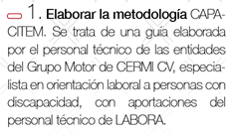
Notes:
This innovative project is divided into 3 operational objectives:
1. Develop the methodology.
CAPACITEM. This is a guide developed by the technical staff from organisations under the Committee of Entities Representing People with Disabilities in the Valencian Community (CERMI CV), specialising in job orientation for people with disabilities, with support from technical staff at LABORA.
2. Train and educate
LABORA staff and staff at Support Units for Special Employment Centres in this methodology.
3. Establish a network
(xarxa, in Valencian) through synergy between the organisations and technical staff for job orientation that have taken part in the project.

